Slide 1
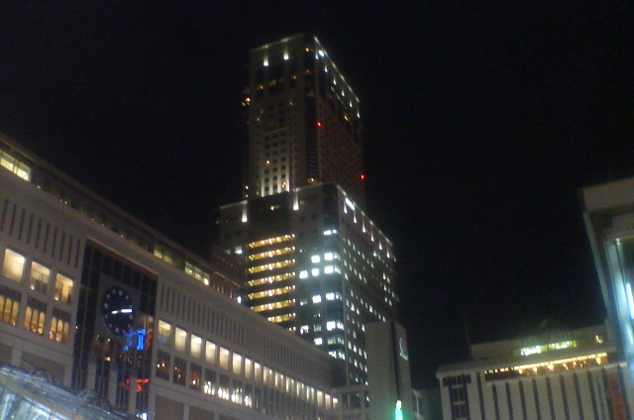
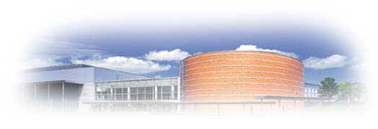
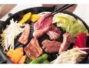
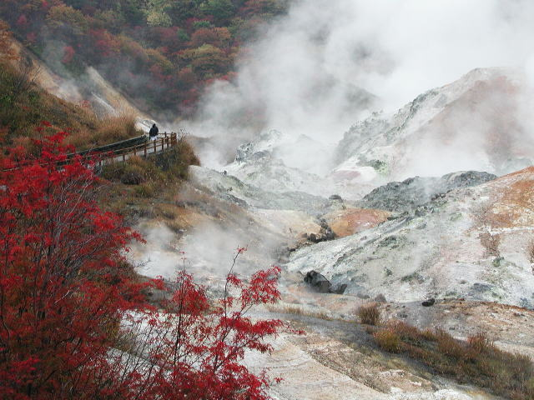
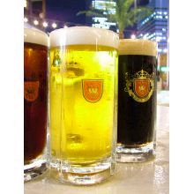
Scientific Excursion
Wed. July 21, 2010
Time Schedule
12:15
Departure (1 h in Bus including Lunch time)
13:15 – 15:00
Visiting Beer Factory (Sapporo or Kirin)
15:00
Departure (1 h Bus trip to Noboribetsu)
16:00 – 17:30
Visiting JIGOKU DANI (The Hell valley)
17:30
Departure (1.5 h Bus trip to Sapporo)
19:00 – 21:00
Dinner at Sapporo Beer Garden
21:30
Arriving at Sapporo Station
Sapporo
Convention
Center
Please take a LUNCH BOX
before rushing into a Bus !
Sapporo ST.
“Genghis
Khan” Dinner
Sapporo Beer
Garden
Hot spring Heaven
“The Hell valley”
JIGOKU DANI
in Noboribetsu
Beer Factory

Slide 2
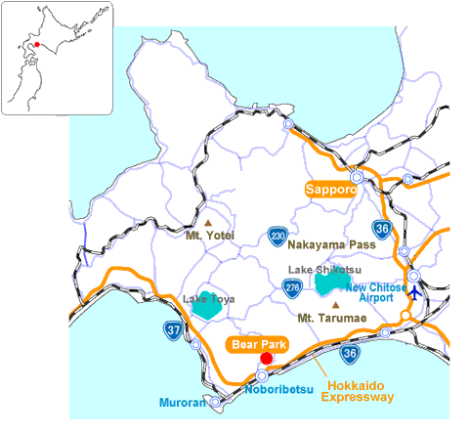
Route Map
Sapporo Convention
Center
Beer Factory
JIGOKU DANI
Attention please !!
*1 Registration is necessary at the Scientific Excursion Desk
by 1:30pm, Tuesday afternoon. (First-come-first-served basis.)
*2 Please be reminded that excursion enrollment will be limited to
400 participants due to the limited capacity of each venue.
*3 This excursion includes both lunch and dinner (free of charge).

