Slide 1

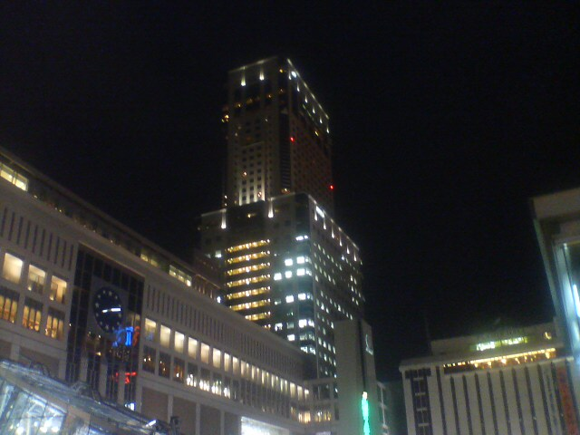

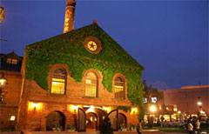
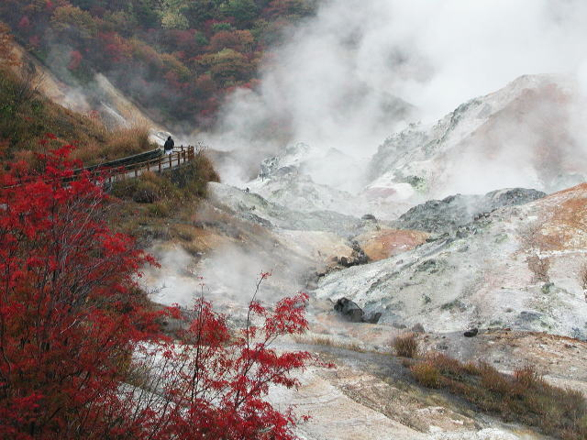
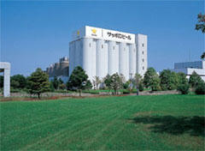
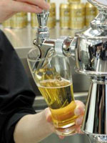
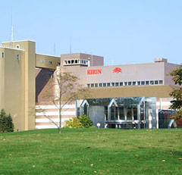
Scientific Excursion
Wed. July 21, 2010
Time Schedule
12:15
Departure (1h bus trip including lunch time)
13:15 – 15:00
Visiting beer brewery (Sapporo or KIRIN)
15:00
Departure (1h bus trip to Noboribetsu)
16:00 – 17:30
Visiting JIGOKU DANI (The Hell Valley)
17:30
Departure (1.5h bus trip to Sapporo)
19:00 – 21:00
Dinner at Sapporo Beer Garden
21:30
Arriving at Sapporo Station
Sapporo
Convention
Center
Please take a LUNCH BOX
before rushing into a bus !
Sapporo ST.
“Genghis
Khan” Dinner
Sapporo Beer
Garden
Hot spring Heaven
“The Hell Valley”
JIGOKU DANI
in Noboribetsu
Beer Brewery

Slide 2
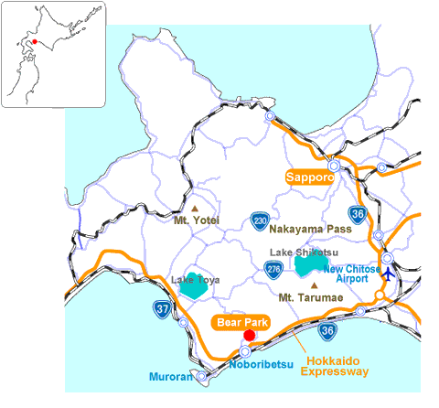
Route Map
Sapporo Convention
Center
Sapporo
Beer Breweries
Noboribetsu
JIGOKU DANI
Attention please !!
Registration is necessary at the Tour Desk by Tuesday afternoon (13:30pm).
(Please bring the excursion ticket attached with your name card.)
We accept only the first 400 persons.
This excursion includes both an optional lunchbox and dinner.
You will be able to choose your lunch among a few kinds of lunch boxes including vegetarian one.
The experience of bathing in Noboribetsu hot spring is also available.
(The fee is not included. You have to pay 1,500 yen by yourself.)

