Slide 1

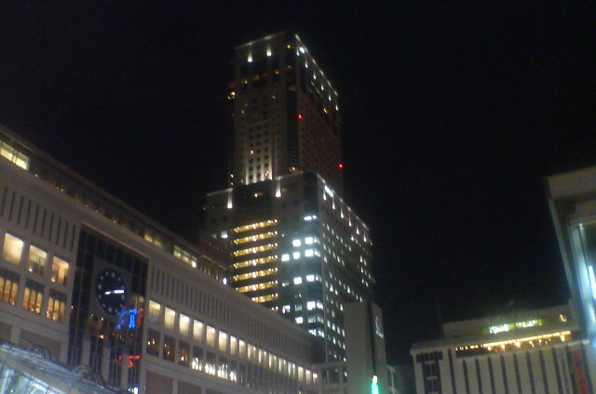

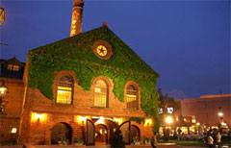
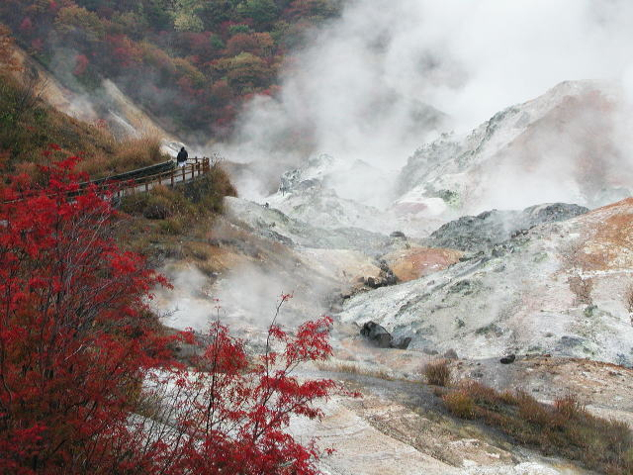
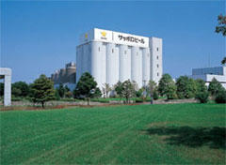
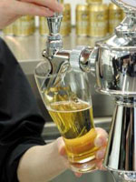
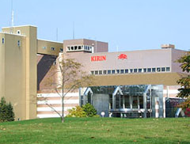
Scientific Excursion
Wed. July 21, 2010
Time Schedule
12:15
Departure (1h Bus including Lunch time)
13:15 – 15:00
Visiting Beer Factory (Sapporo or Kirin)
15:00
Departure (1h Bus trip to Noboribetsu)
16:00 – 17:30
Visiting JIGOKU DANI (The Hell Valley)
17:30
Departure (1.5h Bus trip to Sapporo)
19:00 – 21:00
Dinner at Sapporo Beer Garden
21:30
Arriving at Sapporo Station
Sapporo
Convention
Center
Please take a LUNCH BOX
before rushing into a Bus !
Sapporo ST.
“Genghis
Khan” Dinner
Sapporo Beer
Garden
Hot spring Heaven
“The Hell Valley”
JIGOKU DANI
in Noboribetsu
Beer Factory

Slide 2
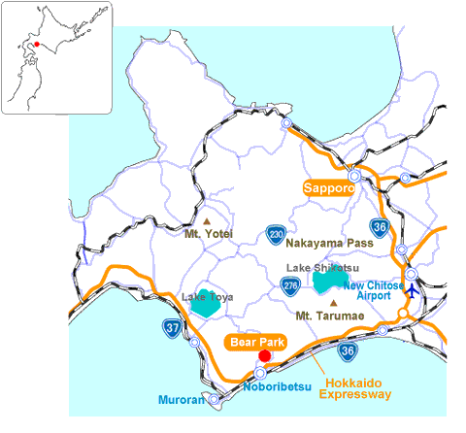
Route Map
Sapporo Convention
Center
Beer Factory
JIGOKU DANI
Attention please !!
Registration is indispensable at the Tour Desk by Tuesday afternoon (13:30pm).
(Please bring the excursion ticket attached with your name card)
We accept only the first 400 persons.
It will be closed when we reach 400 applicants.
This excursion includes both an optional lunchbox and dinner. You will be able to choose your lunch among a few kinds of lunch boxes including vegetarian one.

